Slide 1
CUSTOMER SATISFACTION ANALYSIS OF SOUTHEAST AIRLINES
IST687 – Final project
By: Ananth Adisesh

Slide 2
Project data and problems
Loyalty program used in the industry for customers does not work well today.
Customer churn is lagging.
Finding good indicators to suggest customer satisfaction and reduce customer churn.
The dataset contains 10,282 rows and 32 columns of data which can be analyzed to suggest better customer satisfaction.

Slide 3
Business questions
Objective: To provide suggestions for best practices to reduce customer churn for Southeast Airlines.
How important is age and gender as a factor to determine customer’s airline rating and travel frequency?
How to use a customer’s Likelihood to recommend an airline as a factor to correlate LTR to other factors such as Age, Gender, Origin City, Destination City, Comments etc.
How to use comments and feedbacks by customers to determine if their responses are positive or negative in order to understand if the customer is likely to use the airline again.
Analyze the diverse set of customer base that the airline possess.
Finding out the origin states having less likelihood to recommend.

Slide 4
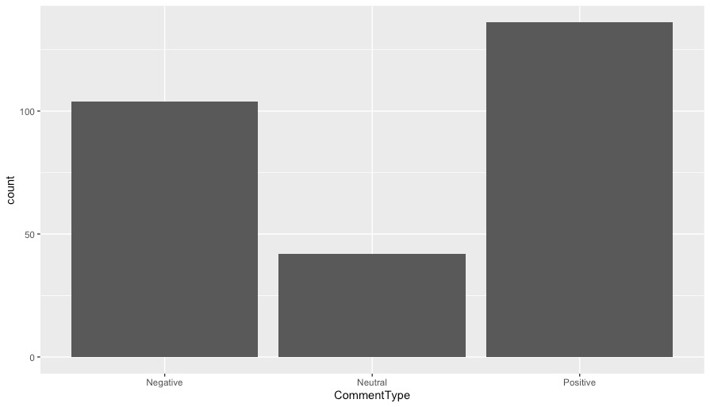
Visualizations

Slide 5
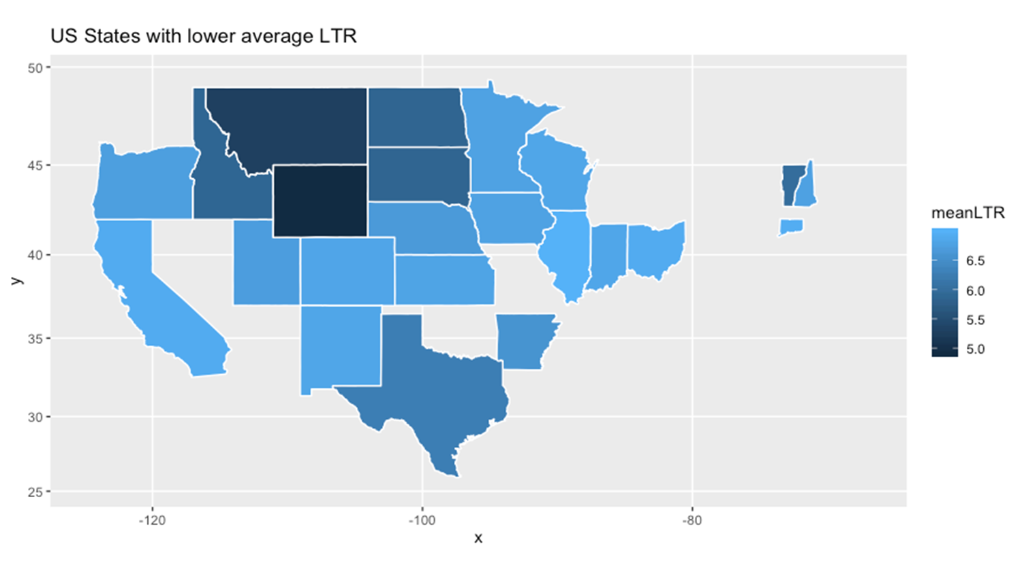
Visualizations (Continued)

Slide 6
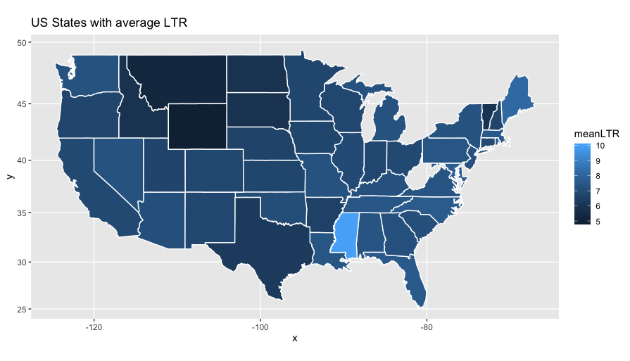
Visualizations (Continued)

Slide 7
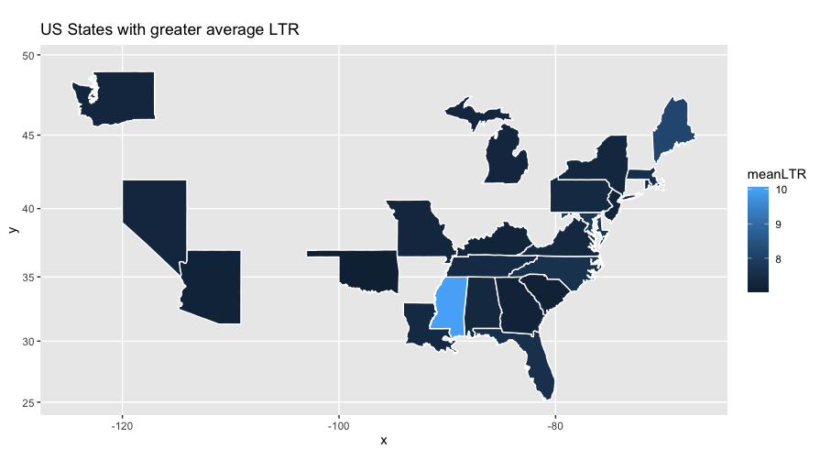
Visualizations (Continued)

Slide 8
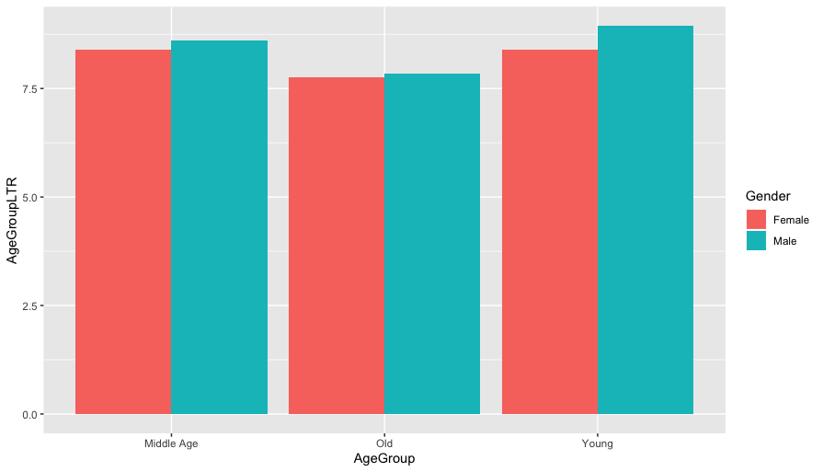
Visualizations (Continued)

Slide 9
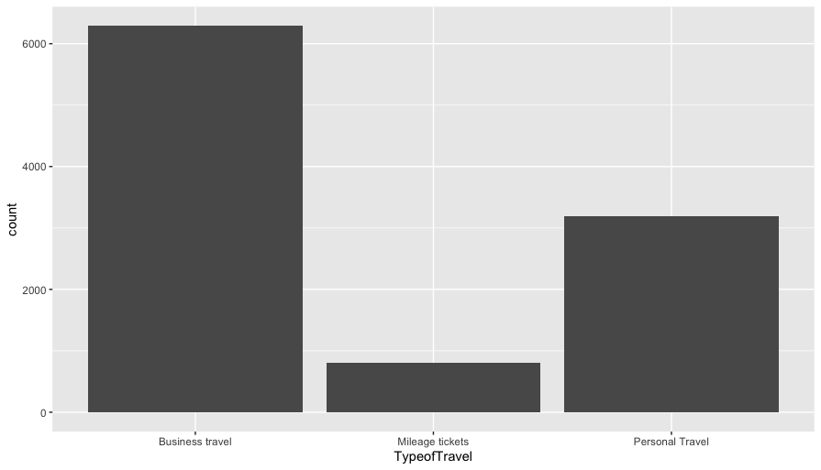
Visualizations (Continued)

Slide 10
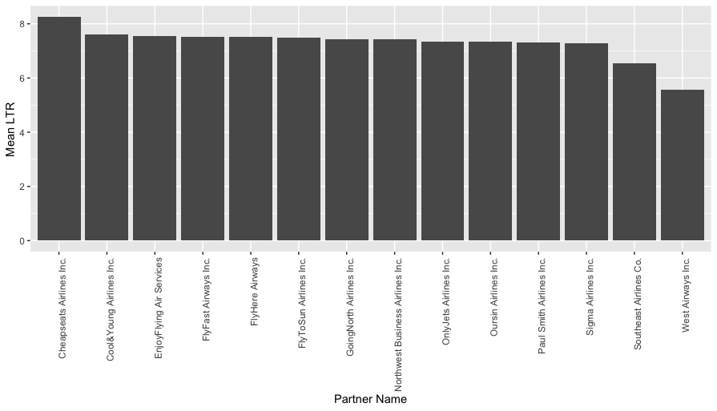
Visualizations (Continued)

Slide 11
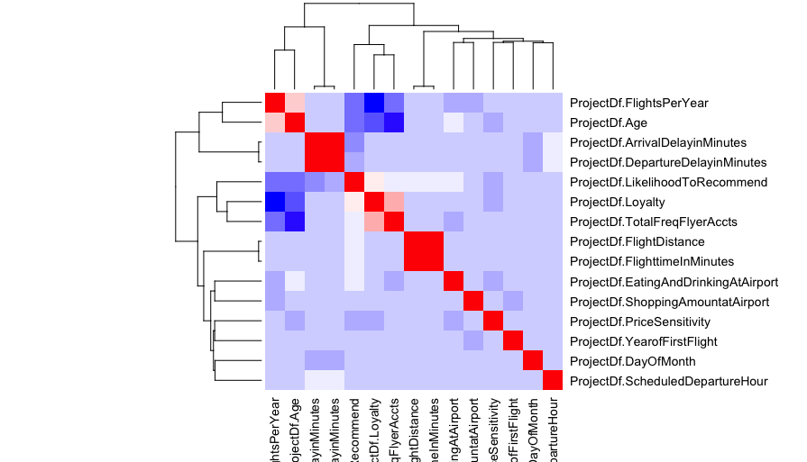
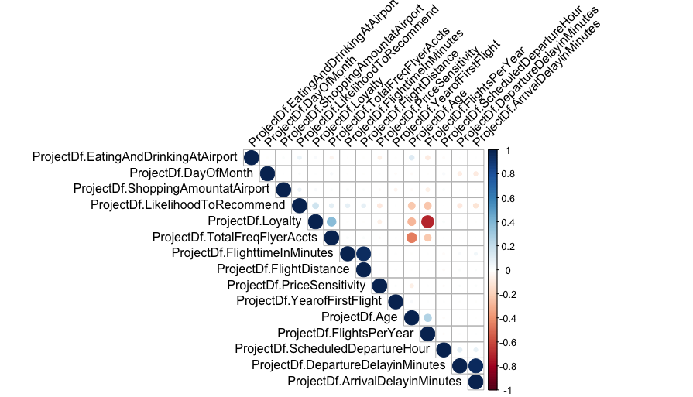
Visualizations (Continued)

Slide 12
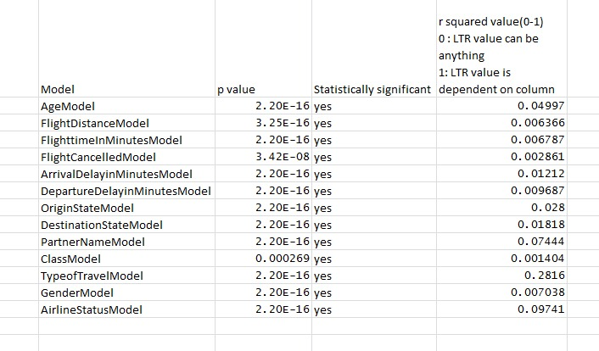
Linear Regression Model

Slide 13
Actionable insights
Improve services in states where customers tend to have lower satisfaction by offering deals and discounts.
Provide better services and assistance to old people.
Female customers tend to give poor recommendation amongst all age groups, thus improve service and customer experience to women by offering special loyalty deals for women.
The loyalty is more leaned towards other airline so in order to reduce customer churn, more benefits can be provided to loyal customers based on priority.
Offering discounts on first travel and subsequent travels to ensure customers book the flight again.

Slide 14
Thank You. Q&A session.

